Slide 1
Decorator Design Pattern
The Decorator pattern extends (decorates) an object’s behavior dynamically.
The ability to add new behavior at runtime is accomplished by a Decorator object which ‘wraps itself’ around the original object.
Multiple decorators can add or override functionality to the original object.
The Decorator pattern isn't heavily tied to how objects are created but instead focuses on the problem of extending their functionality.
@ShankaragoudaG

Slide 2
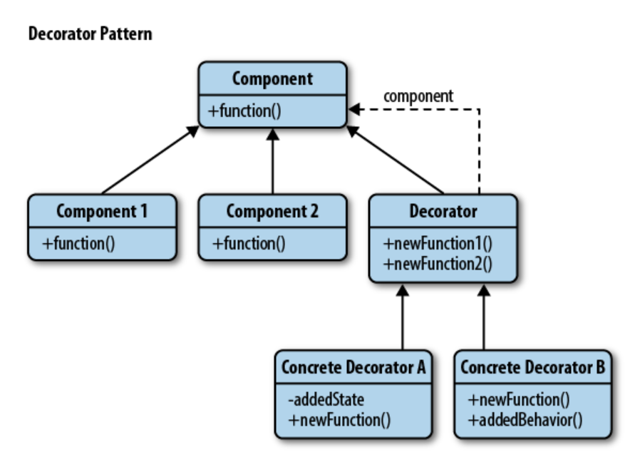
Decorator Pattern Diagram

Slide 3
Participants
Client:
maintains a reference to the decorated Component
Component:
object to which additional functionality is added
Decorator:
'wraps around' Component by maintaining a reference to it
defines an interface that conforms to Component's interface
implements the additional functionality (addedMembers in diagram)

Slide 4
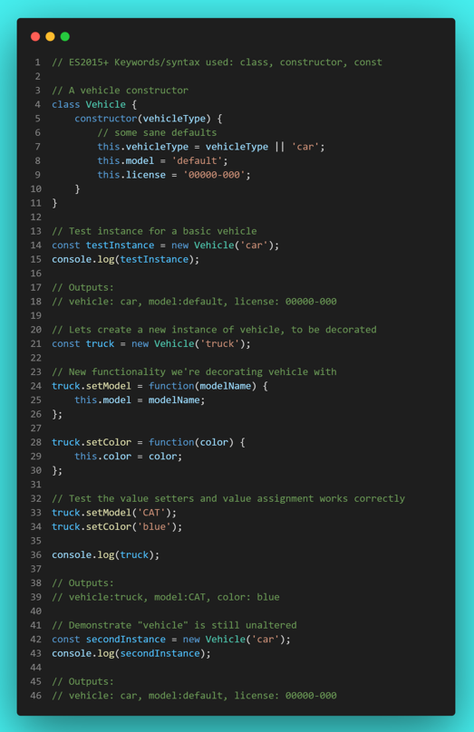
Example

Slide 5
Advantages
Developers enjoy using this pattern as it can be used transparently and is also fairly flexible - as we've seen, objects can be wrapped or "decorated" with new behavior and then continue to be used without needing to worry about the base object being modified.
In a broader context, this pattern also avoids us needing to rely on large numbers of subclasses to get the same benefits.

Slide 6
Disadvantages
If poorly managed, it can significantly complicate our application architecture as it introduces many small, but similar objects into our namespace.
The concern here is that in addition to becoming hard to manage, other developers unfamiliar with the pattern may have a hard time grasping why it's being used.

Slide 7
Useful Resources
https://www.dofactory.com/javascript/design-patterns/decorator
https://www.patterns.dev/posts/classic-design-patterns/#mixinpatternjavascript
https://www.oreilly.com/library/view/learning-javascript-design/9781449334840/ch09s14.html

